Slide 1



Bioinformatics analysis shows candidate genes for osteocytes differentially response to different types of mechanical stimuli
Presenter: Ziyi Wang
Authors: Ziyi Wang¹, Yoshihito Ishihara², Naoya Odagaki²,
Ei Ei Hsu Hlaing¹, Hiroshi Kamioka¹
Affiliation:
1. Department of Orthodontics, Okayama University Graduate School of Medicine, Dentistry, and Pharmaceutical Sciences
2. Orthodontic Clinic, Okayama University Hospital
Notes:
I’m very glad to share my own experience here that how did I start my doctoral thesis using bioinformatics analysis.

Slide 2

（公社）日本矯正歯科学会COI開示 The Japanese Orthodontic Society COI Disclosure Ziyi Wang
演題発表に関連し、
開示すべきCOI関係にある企業などはありません
The authors have no financial conflicts of interest
to disclose concerning the presentation.
Notes:
All authors have no conflicts of interest.

Slide 3
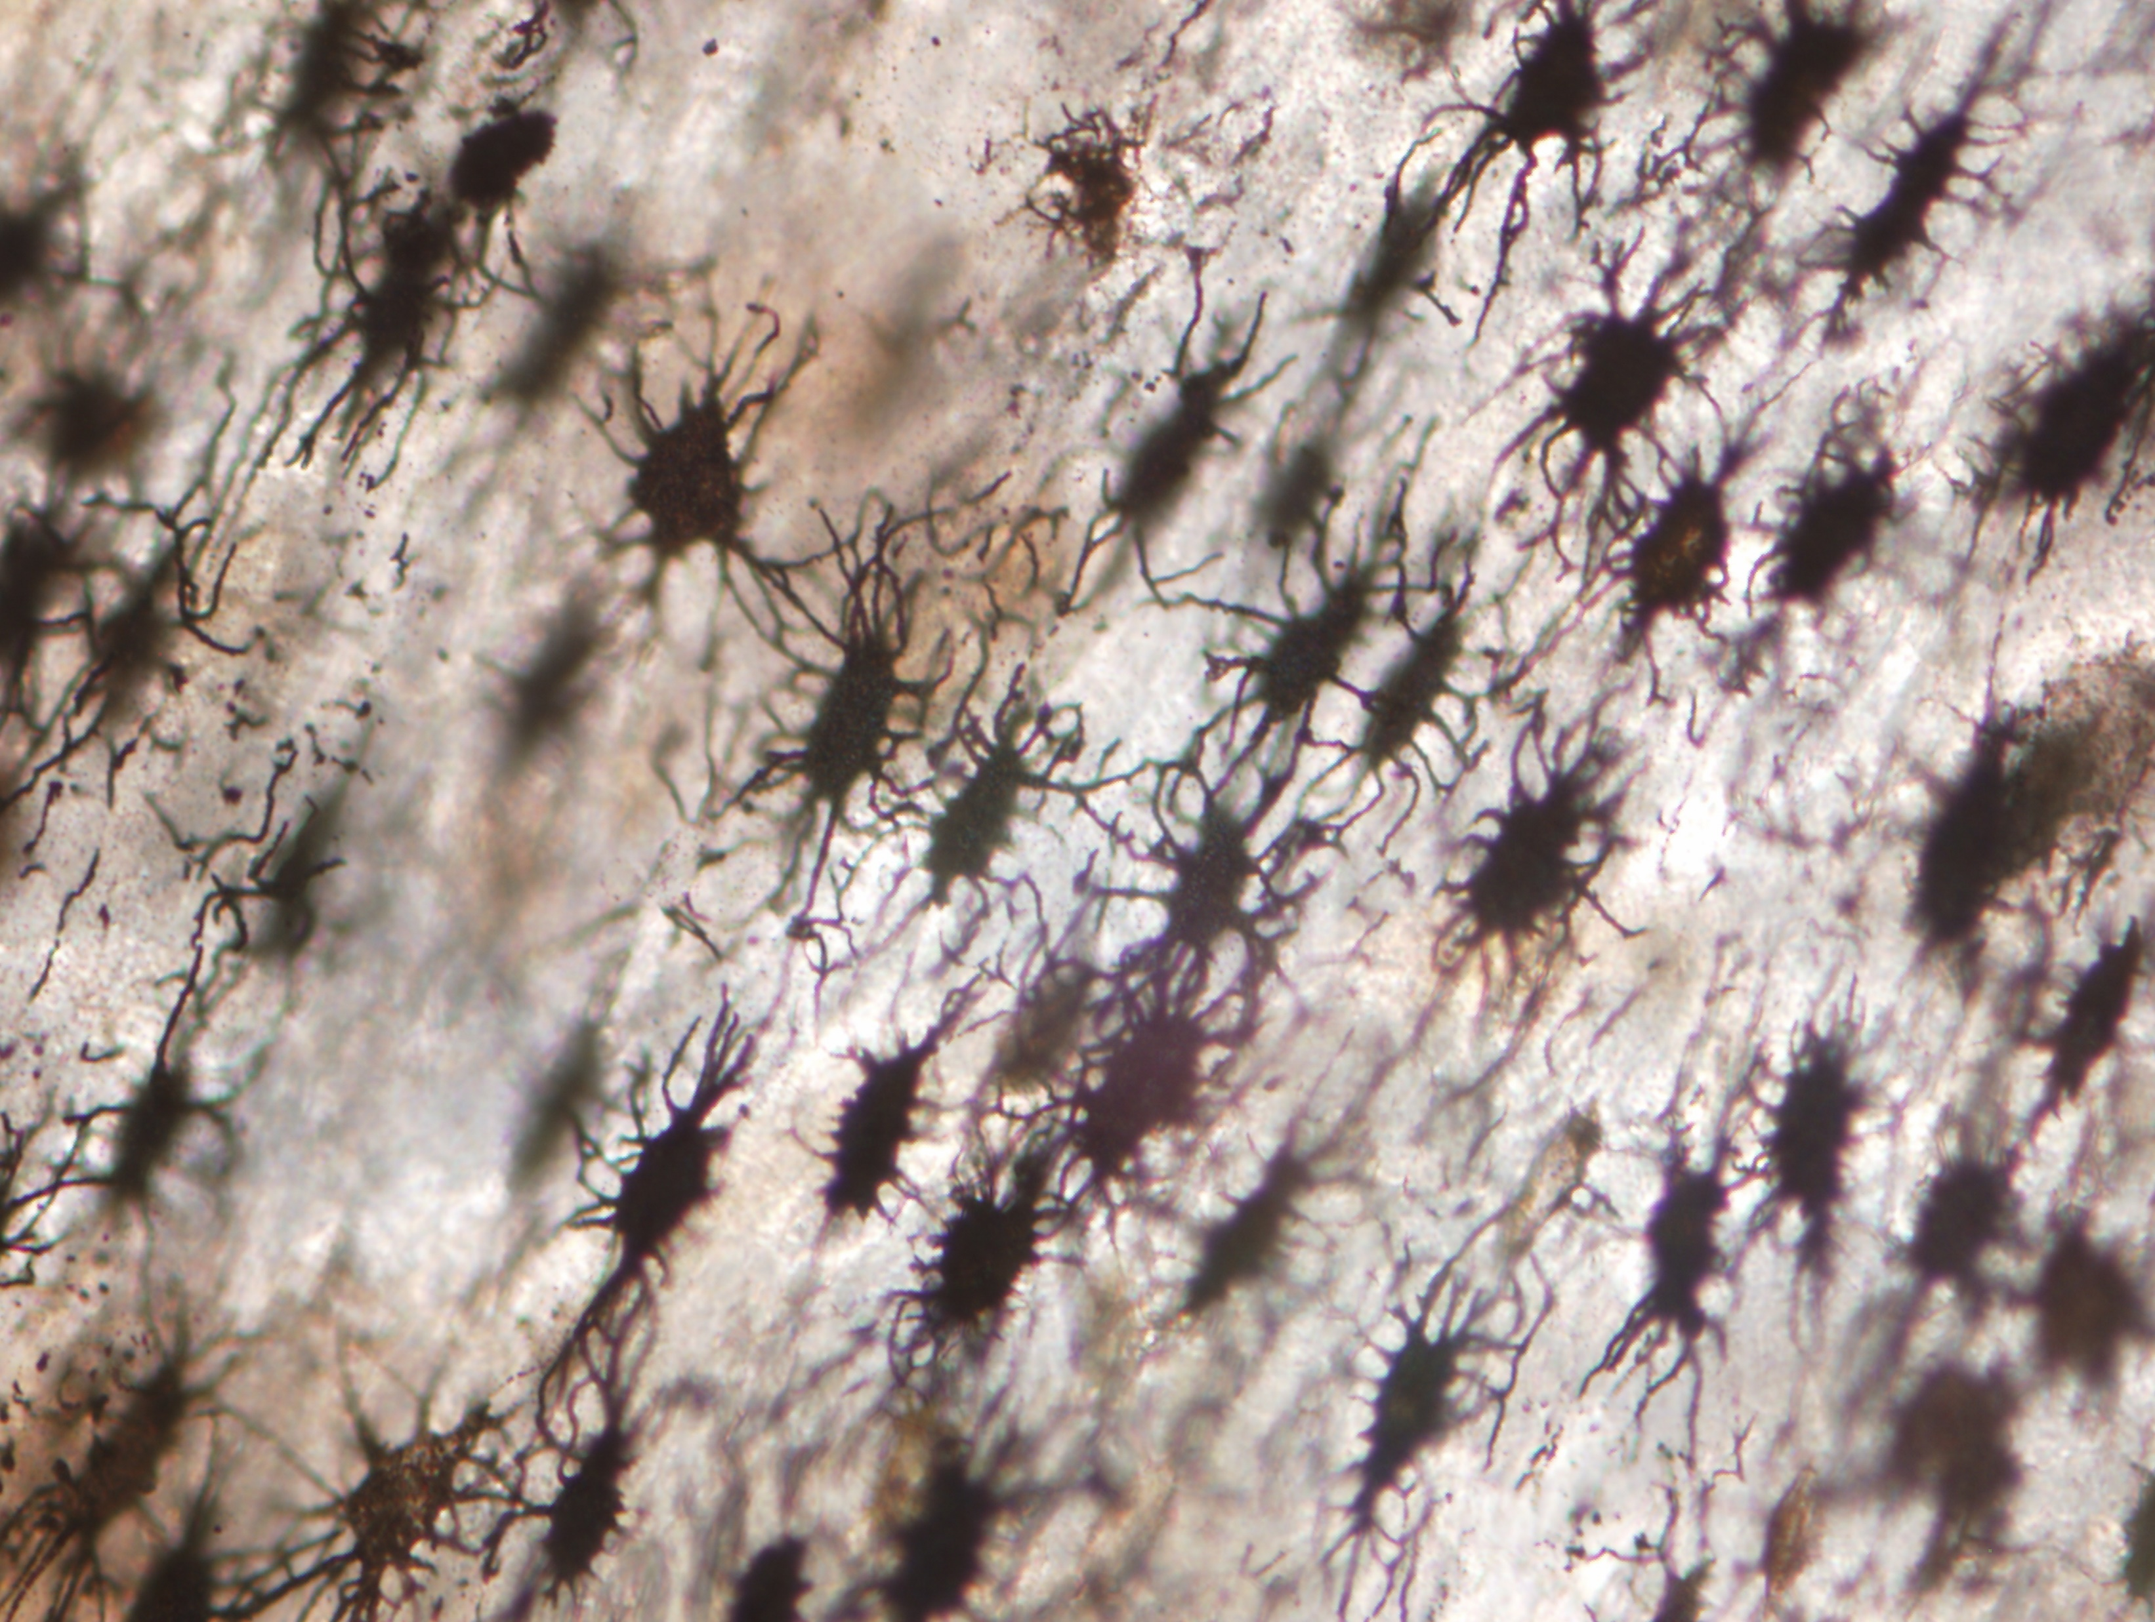
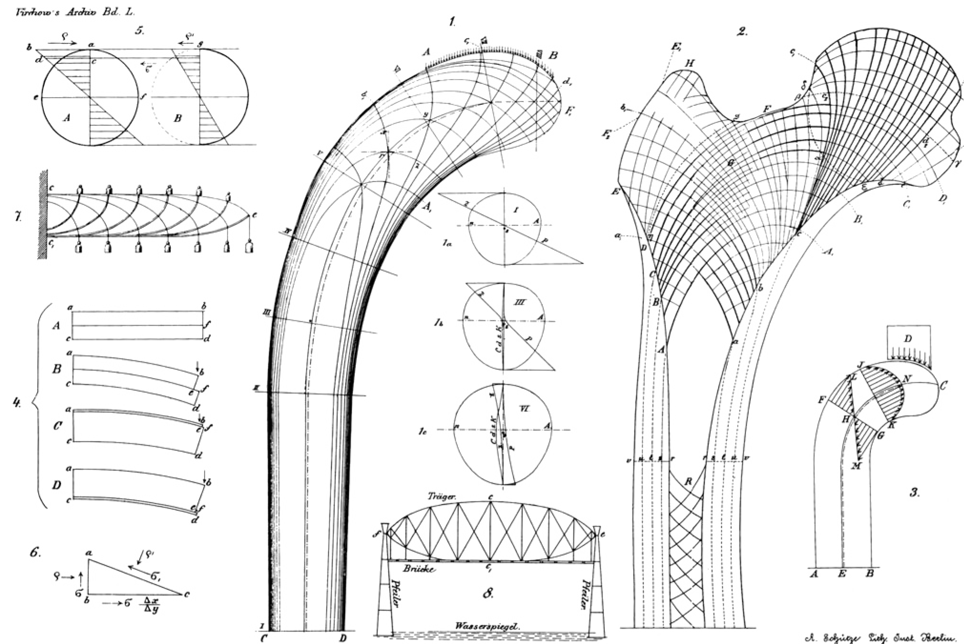
Wolff, Julius. (1870) Archiv für pathologische Anatomie und Physiologie und für klinische Medicin
Background
Wolff’s Law showed that the trabecular structure of bone was closely related to its mechanical loading, which indicates that bone cells can sense the different force-direction, force-strength and force-type and respond to them differentially.
Notes:
More than a century ago we already knew that the trabecular structure of bone was closely related to its mechanical loading, as know as Wolff’s Law. This law indicates that bone cells could recognize different force-type (such as gravity and shear stress) and respond to them differentially.

Slide 4
Background
Wolff’s Law showed that the trabecular structure of bone was closely related to its mechanical loading.
Wolff, Julius. (1870) Archiv für pathologische Anatomie und Physiologie und für klinische Medicin
Wolff’s Law
Bone cells
sense different force-types,
and respond to them differentially
Notes:
More than a century ago we already knew that the trabecular structure of bone was closely related to its mechanical loading, as know as Wolff’s Law. This law indicates that bone cells could recognize different force-type (such as gravity and shear stress) and respond to them differentially.

Slide 5
Wolff, Julius. (1870) Archiv für pathologische Anatomie und Physiologie und für klinische Medicin
Background
Wolff’s Law showed that the trabecular structure of bone was closely related to its mechanical loading.
Osteocyte is the major sensor for mechanical loading
Notes:
The osteocytes as the most cells in the bone, embedded in the mineralized bone tissue and have a stellate shape. They are connected via a cellular processes. This network has the function to detect the mechanical loading.

Slide 6
Wolff, Julius. (1870) Archiv für pathologische Anatomie und Physiologie und für klinische Medicin
Objective
In Osteocytes:
What genes are most sensitive to mechanical loading?
How do these genes impact the bone metabolism?
Notes:
So, our objective of this study is to find out which genes are most sensitive to the different type of mechanical loading in osteocytes. And try to investigate that how do these genes impact the bone metabolism?

Slide 7
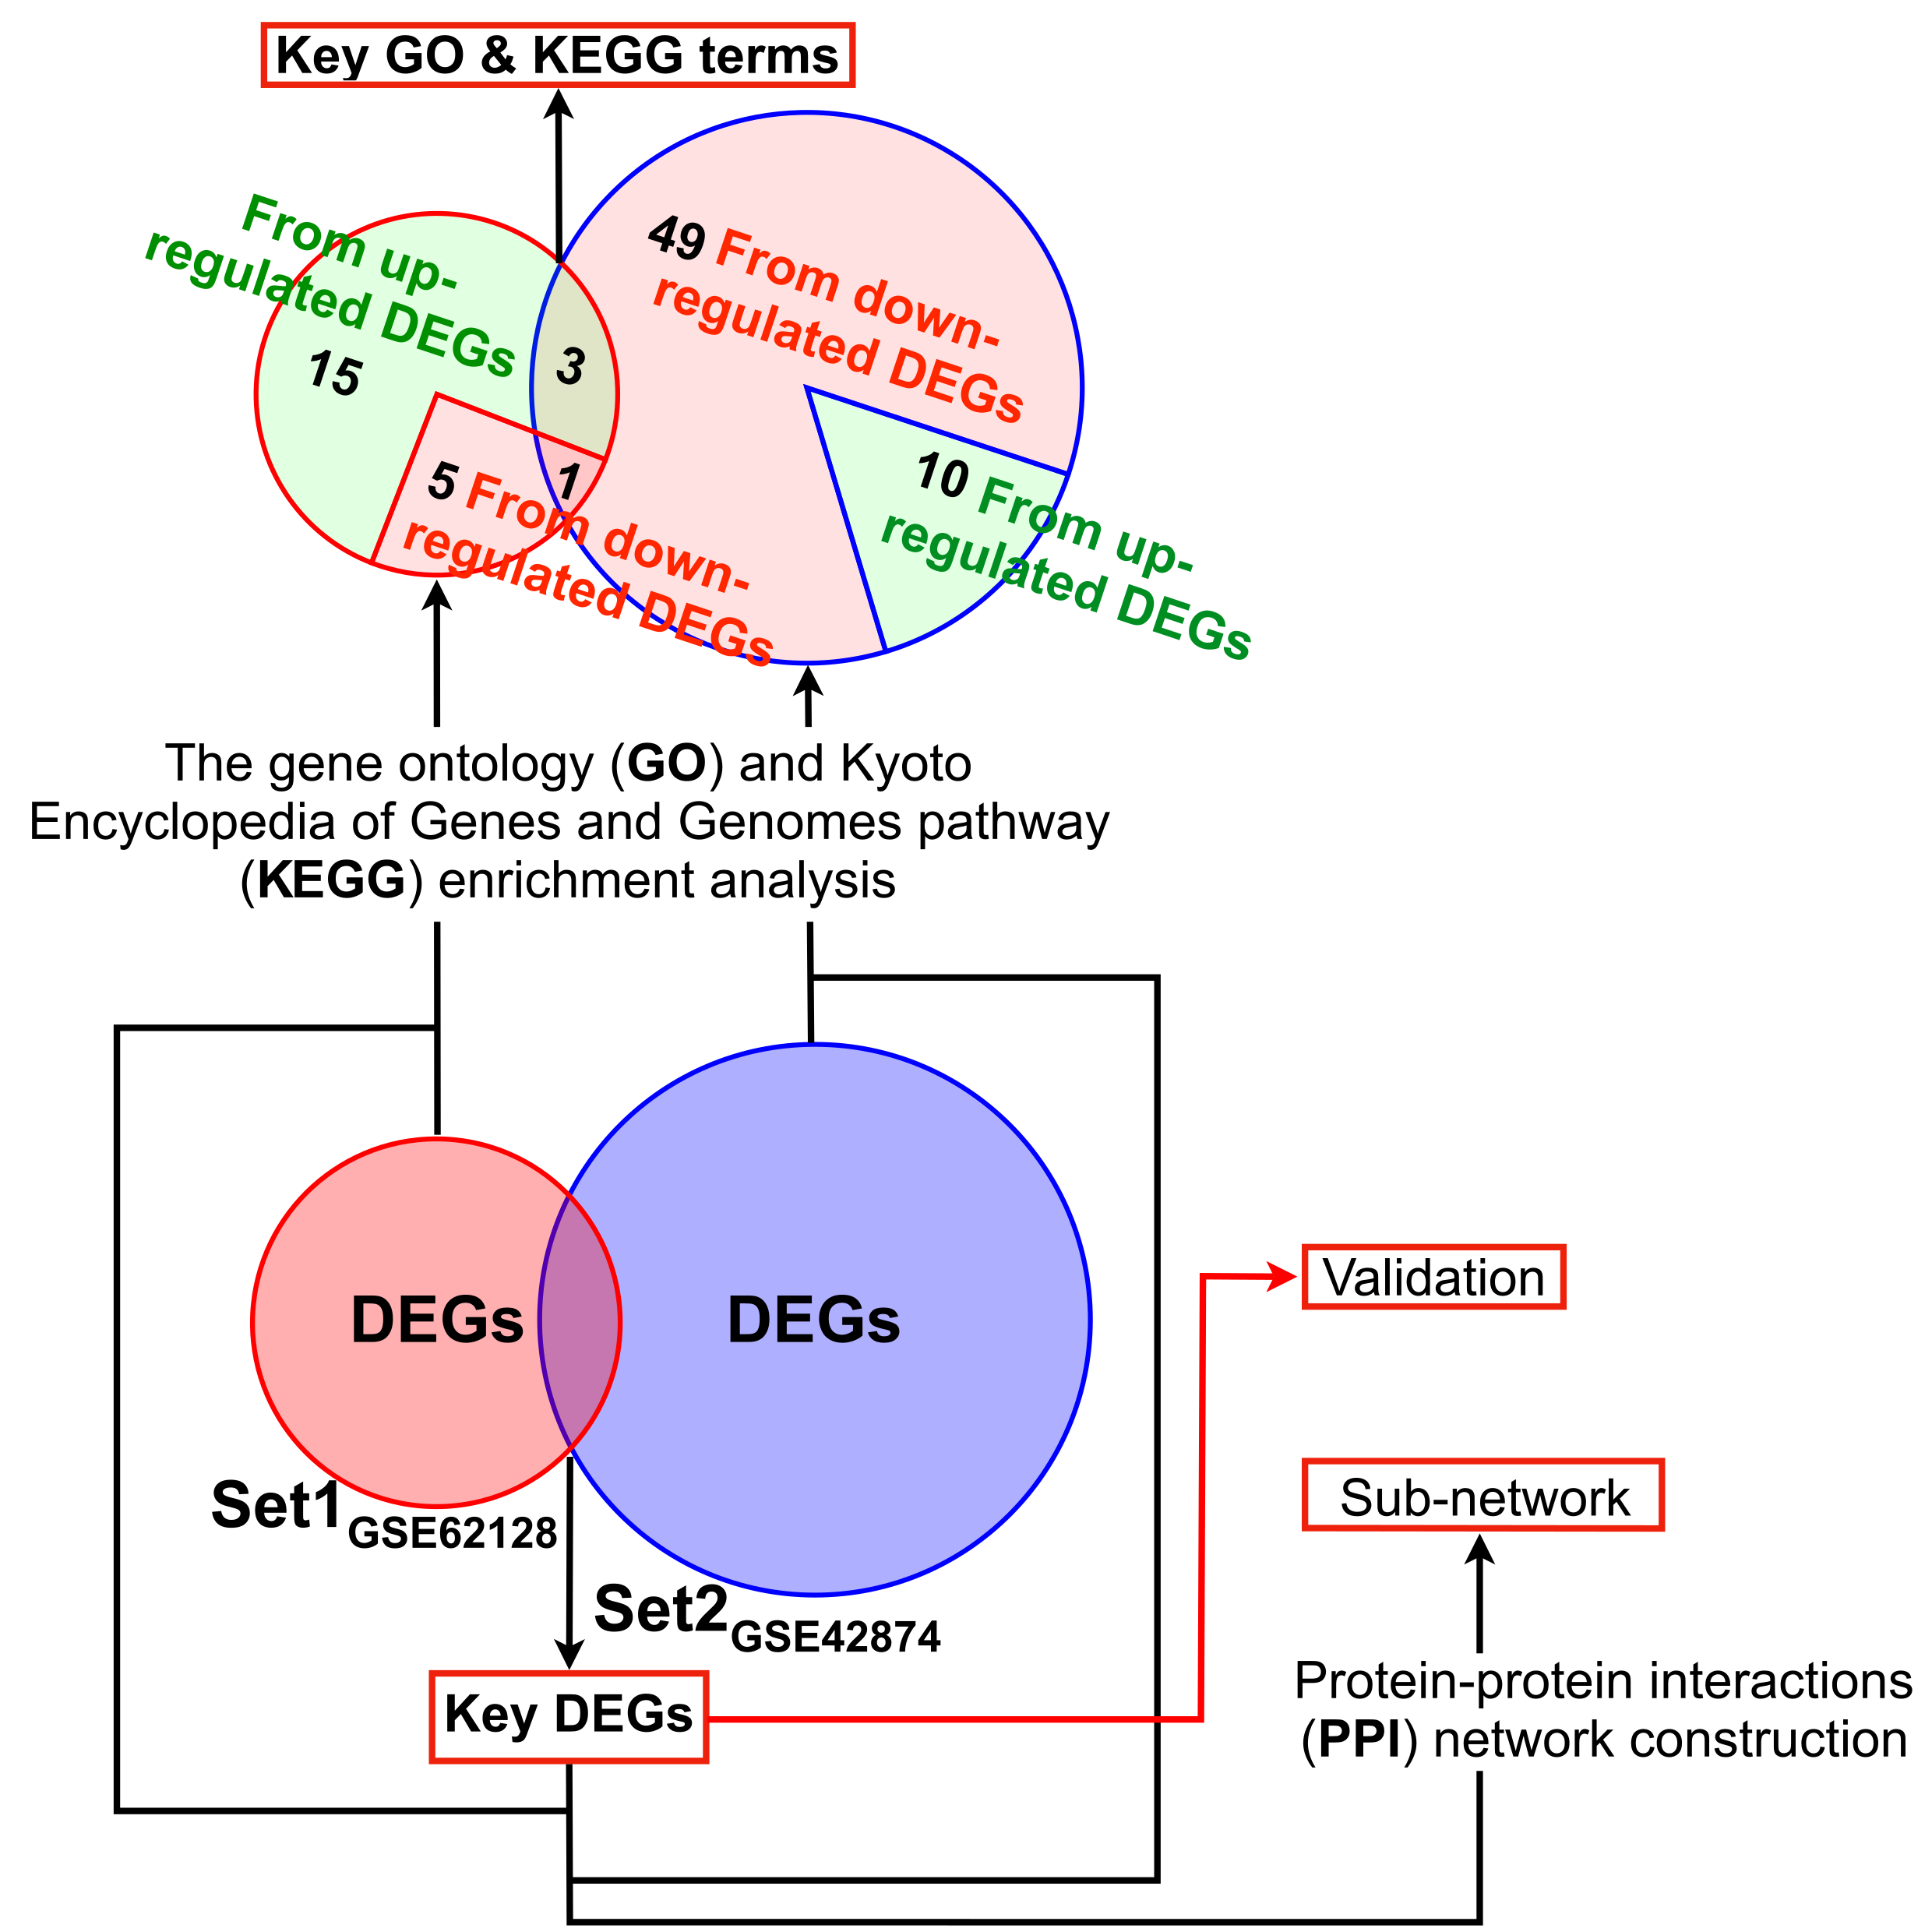
Strategy
Work Flow of This Study
Bioinformatic analysis
Validation experiments
Review of previous studies
Notes:
First, we find out some candidate genes by using bioinformatic analysis. Then, several in vitro experiments were performed to validate these genes. Finally, determined the potential role of these genes in bone modeling and remodeling by reviewing of previous studies.

Slide 8
Part 1:
Bioinformatic Analysis
Notes:
Let’s start the first part: bioinformatic analysis

Slide 9
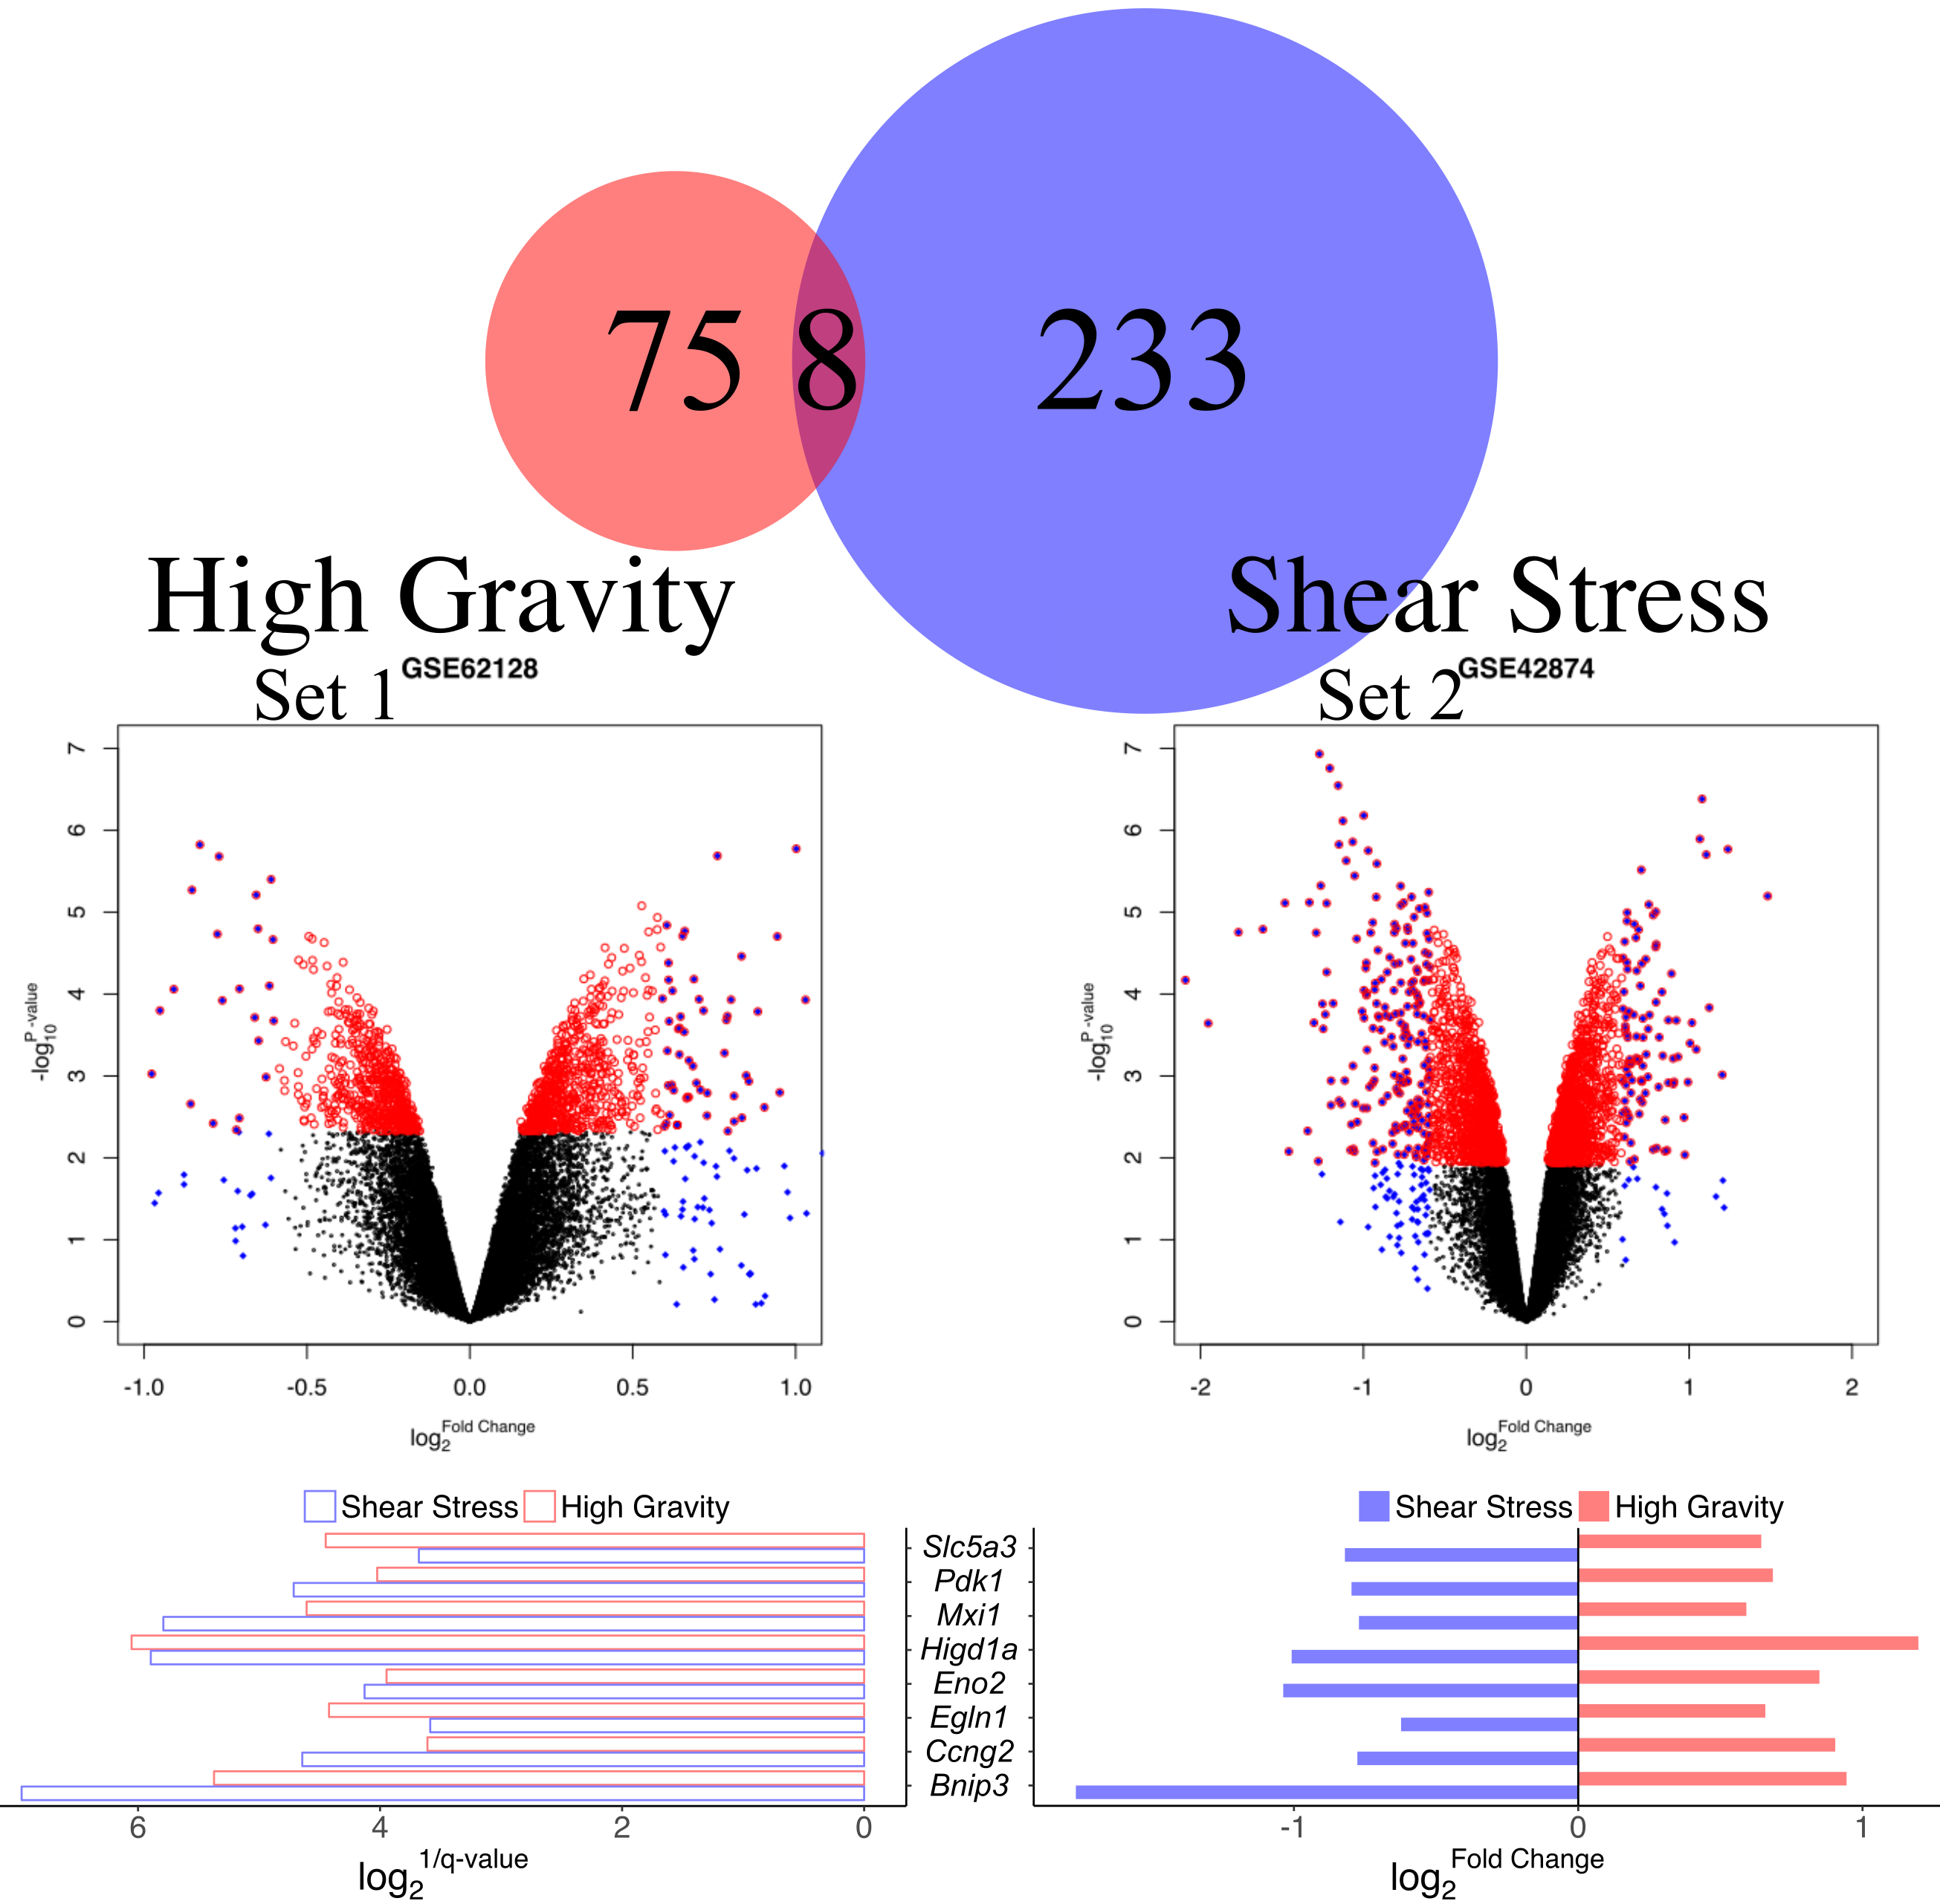
Two datasets were downloaded from the GEO database.
high gravity
vs
shear stress
8 common differential expressed genes (DEGs) were identified.
Gene Expression Omnibus (GEO)
MLO-Y4 osteocytes
Notes:
Two datasets were downloaded from the GEO database. Set One is high gravity treated and Set Two is shear stress treated. Both of them used the MLO-Y4 osteocytes cell line. 8 common differential expressed genes were identified as (Click) Key genes in this study.

Slide 10
Two datasets were downloaded from the GEO database.
high gravity
vs
shear stress
8 common differential expressed genes (DEGs) were identified.
Gene Expression Omnibus (GEO)
MLO-Y4 osteocytes
Key Genes
Notes:
Two datasets were downloaded from the GEO database. Set One is high gravity treated and Set Two is shear stress treated. Both of them used the MLO-Y4 osteocytes cell line. 8 common differential expressed genes were identified as (Click) Key genes in this study.

Slide 11
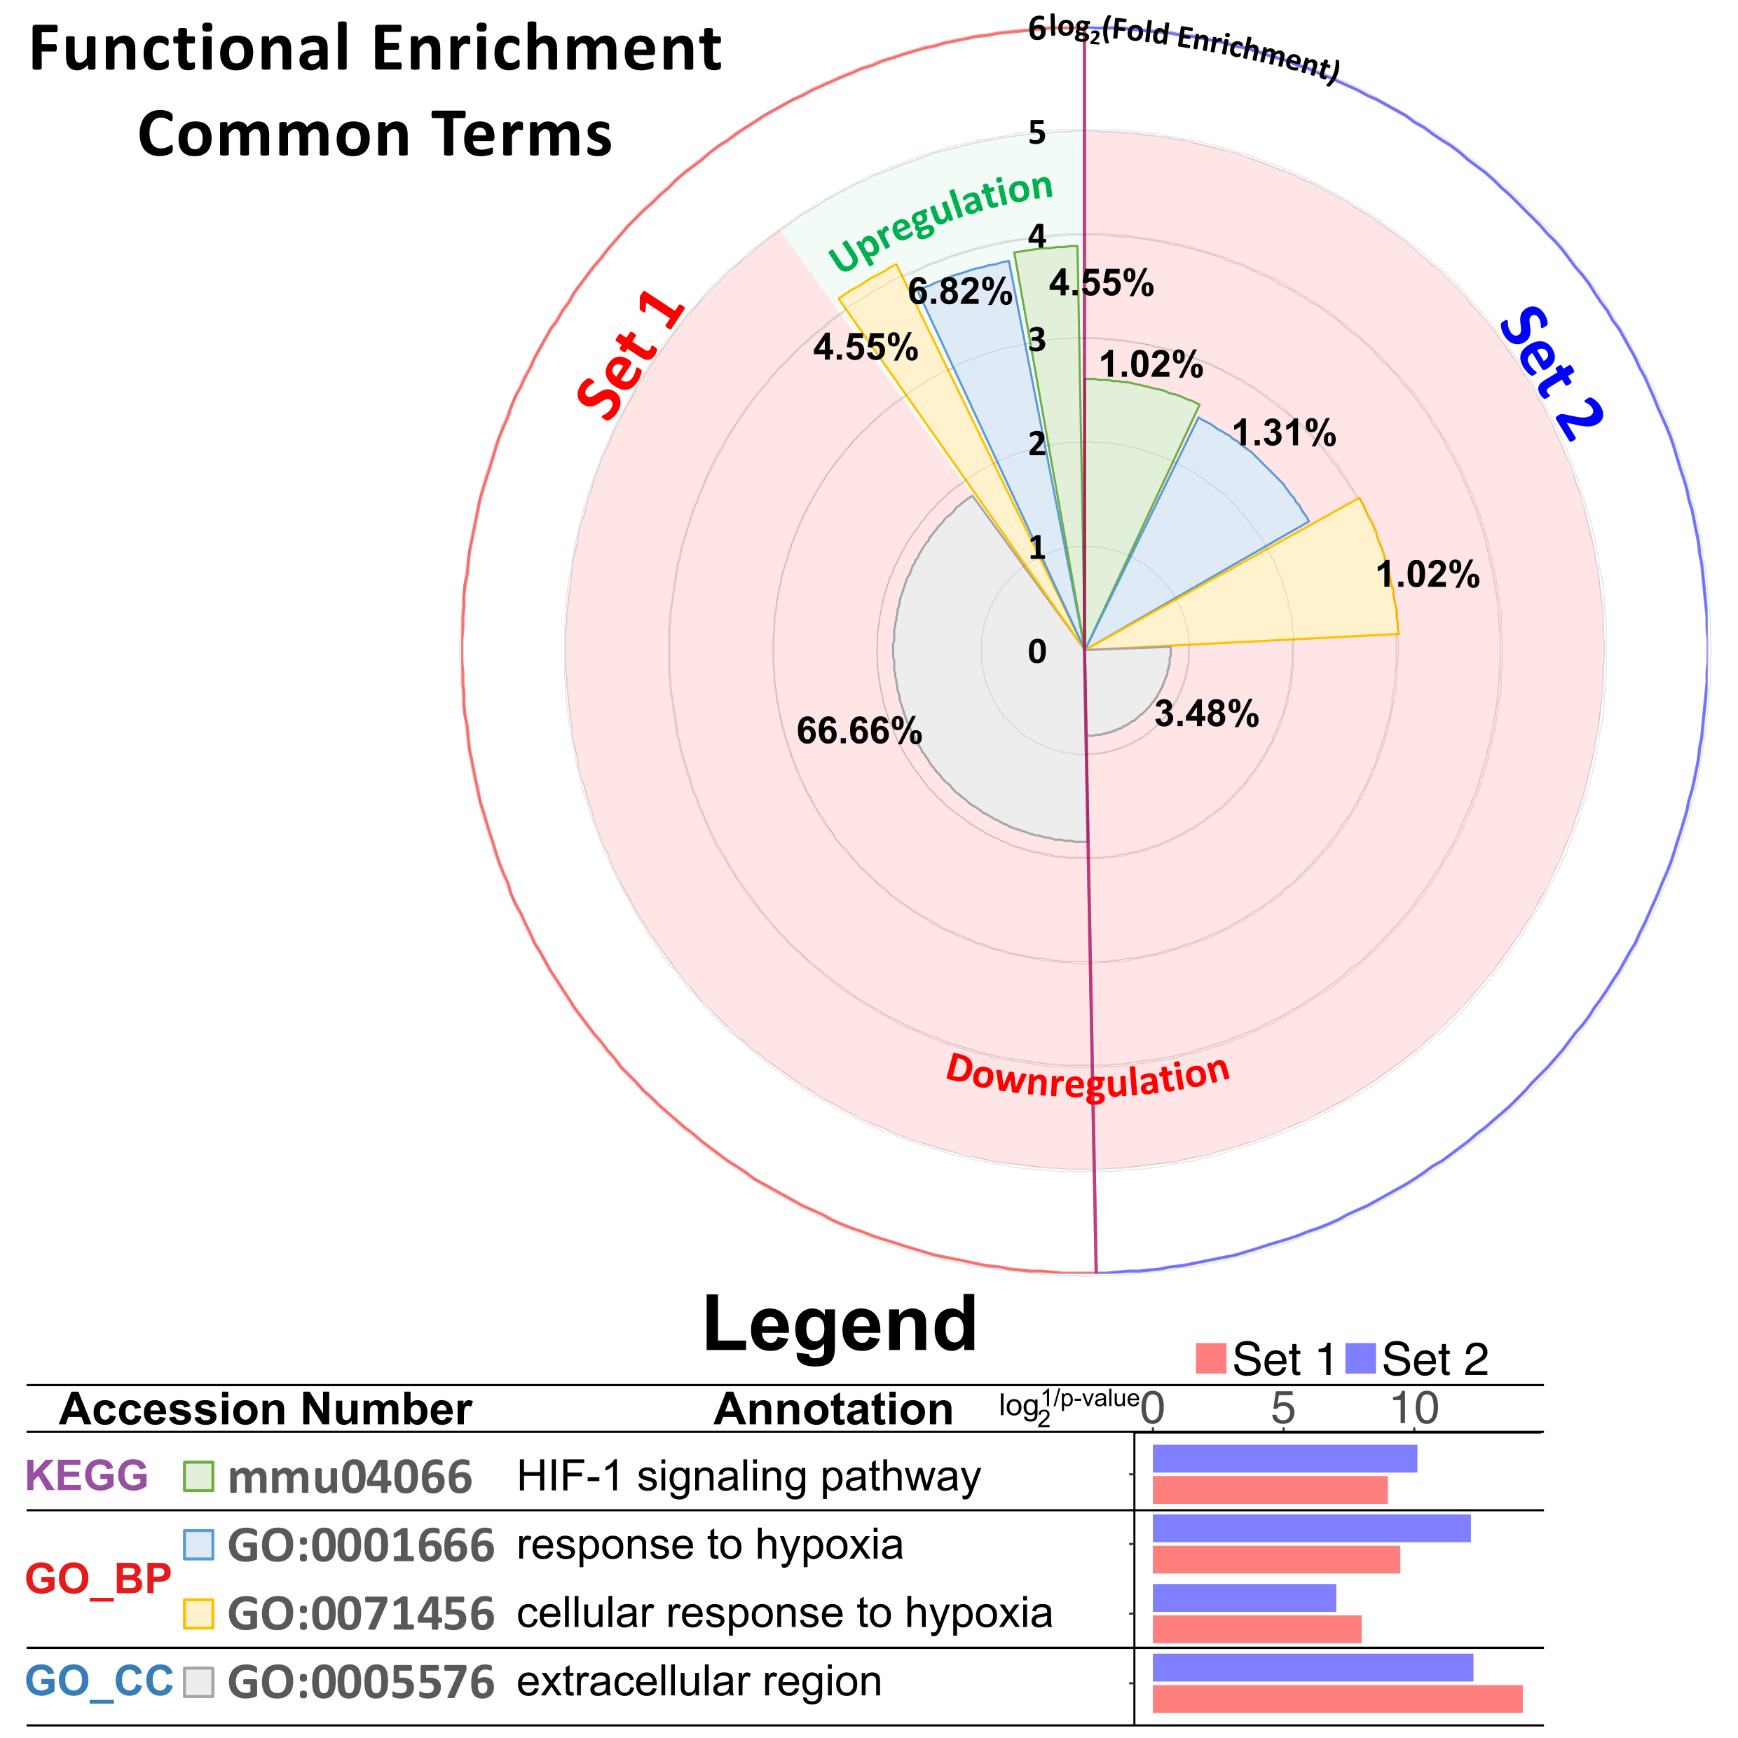
Hypoxic response maybe the key pathway
Notes:
The common functional enrichment was mainly hypoxic response related terms.

Slide 12
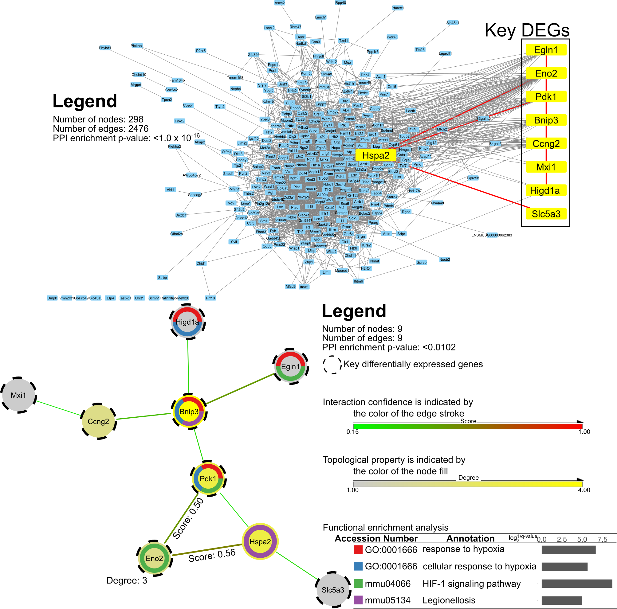
A sub-network was constructed by the shortest path linking all of the Key DEGs to perform functional enrichment.
Notes:
This protein-protein interaction network includes all differential expressed genes from set1 and set2. Then a sub-network was constructed by the shortest path linking all of the 8 common genes.

Slide 13
Eno2
Eno2 was significantly increased in both human PDL cells with compressive stress
De Araujo, R. M. S., Yasuo Oba, and Keiji Moriyama. (2007)
and murine osteoblasts with thapsigargin treatment (ER stress). Also has been identified in exosome.
Hamamura Kazunori, Yunlong Liu, and Hiroki Yokota. (2008) Valadi, Hadi, et al. (2007)
Notes:
Again, this sub-network was enrichment into the terms mainly related to the hypoxic response. In this network, Eno2 was identified as a hub gene. Notably, other studies showed that Eno2 has significantly increased in compressed PDL cells and osteoblast in ER stress. It also has been identified in exosome.

Slide 14
Part 2:
Validation Experiments - based on MLO-Y4 osteocyte cell line
Notes:
Then we performed several in vitro experiments to identify the mechano-sensitive expressed genes from the key genes we found before.

Slide 15
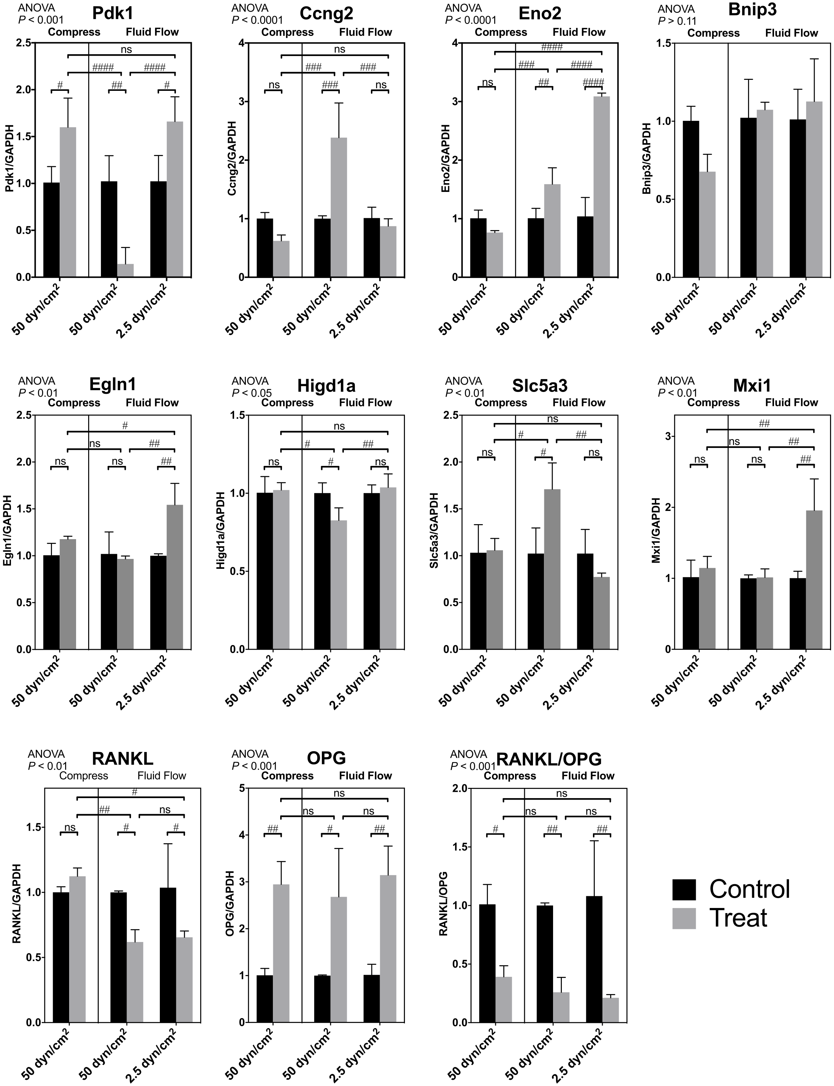
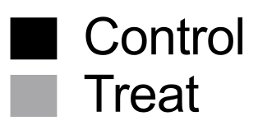
Almost all these key DEGs were mechano-sensitive
Confirmed by RT-PCR
Notes:
7 of these 8 common genes (except for Bnip3) showed extreme mechano-sensitivity revealed by our RT-PCR results. (Click) Moreover, some of them showed opposite expression trends between shear stress and compressive force or between different force strength.

Slide 16
Comparing with RANKL or OPG, the expression of key DEGs showed more mechano-sensitivity
Confirmed by RT-PCR
Notes:
Comparing with RANKL or OPG, the expression of key DEGs showed more mechano-sensitivity.

Slide 17
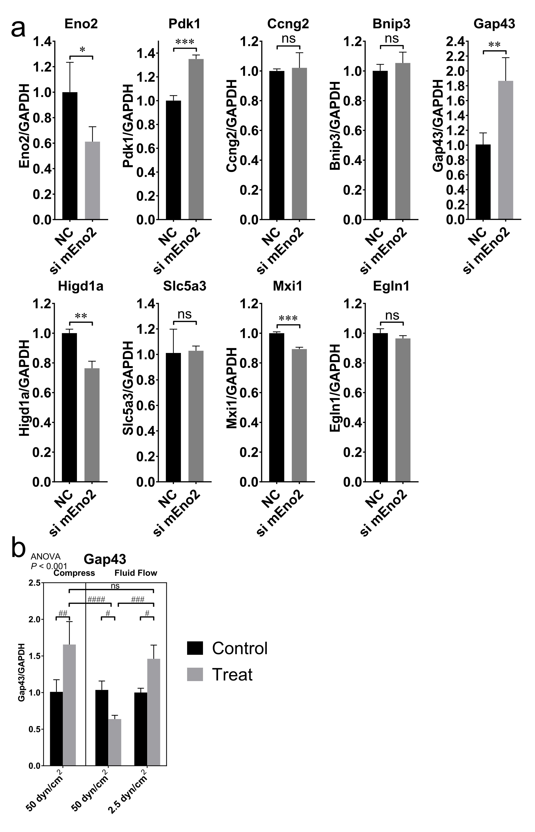
Most of the key DEGs expression were impacted by Eno2 silencing
Notes:
We also validated the role of Eno2 as the hub gene. After knockdown the Eno2, the expression of most of the key genes were impacted.

Slide 18
Convert to Heatmap
Notes:
Those relations were then further confirmed by cluster analysis.

Slide 19
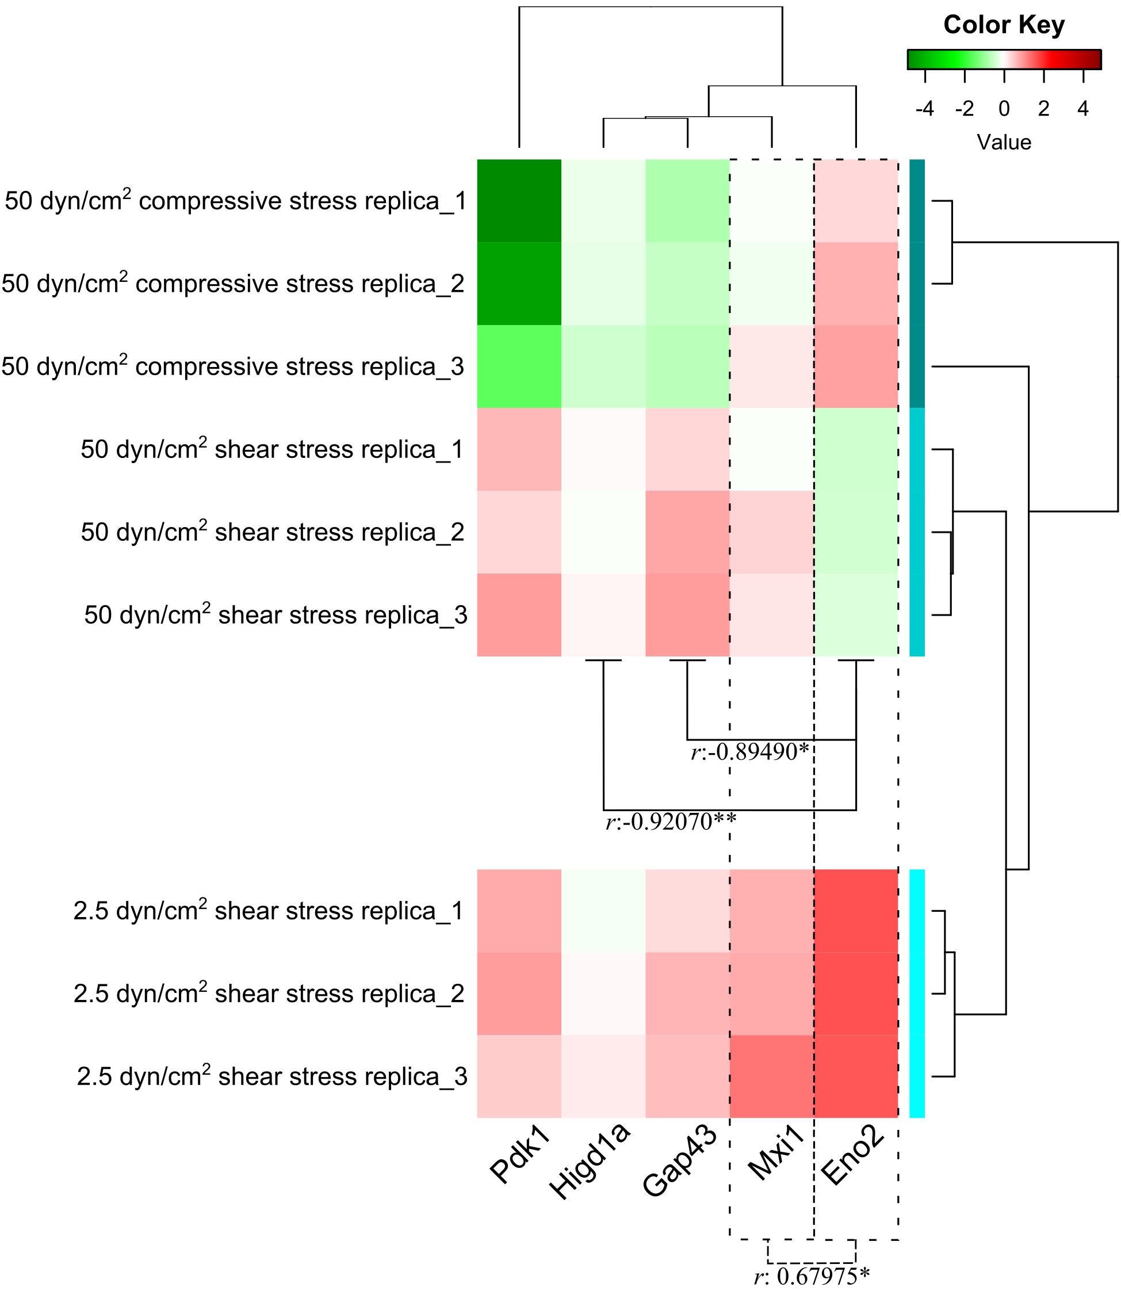
Co-expression pattern was observed
Notes:
Those relationship were then further confirmed by cluster analysis. Co-expression pattern was observed between Eno2 and Mxi1, Gap43 or Higd1a.

Slide 20
Part 3:
Review of Previous Studies
Review of Previous Studies
Notes:
Now the question is: what is the meaning of our findings in bone research field.

Slide 21

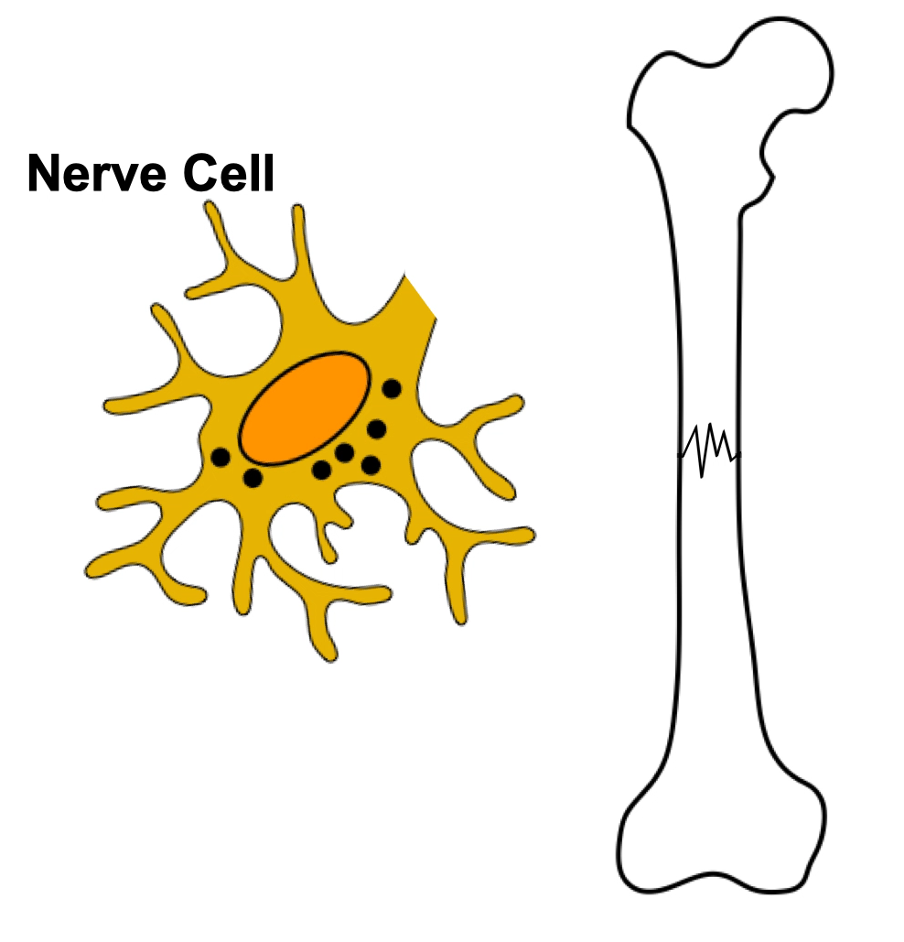
Gene
mRNA
Protein
Eno2
Eno2
Gamma-enolase
Neuromodulin (Gap43)
Egln1
Egln1
Prolyl-4-hydroxylase
(PHD) domain-
containing protein 1
Pdk1
Pdk1
Pyruvate
dehydrogenase
kinase 1
Mxi1
Mxi1
Max-interacting protein 1
Eno2
Messenger?
PDL cells
Osteoblasts
Osteocytes
Slc5a3
Slc5a3
Sodium/myo-inositol transporter
Ccng2
Ccng2
Cyclin-G2
Higd1a
Higd1a
HIG1 domain family 1A
Notes:
As we mentioned before, the hub gene, Eno2, showed inhiation of Gap43. Gap43 encodes a protein called Neuromodulin, which could induce the growth of neural cells processes. Well, does Eno2 involved in the nerve fibers expansion during fracture repair that reported in past? Since the expression of Eno2 was observed in both osteoblast and PDL cells. So, does Eno2 could be a messenger in the cell-cell communication among these cells?

Slide 22
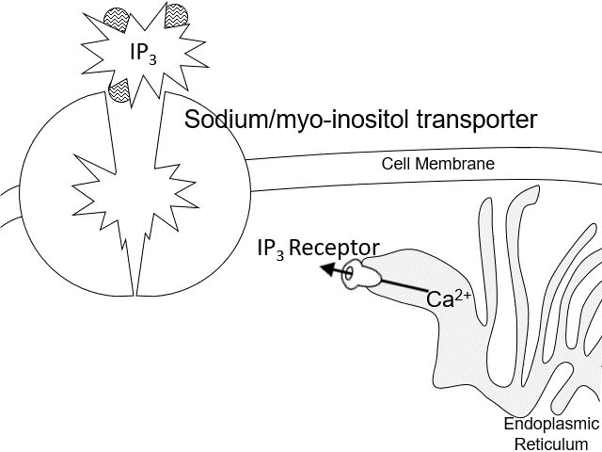
Gene
mRNA
Protein
HIF1-α
Hypoxic Response
Mitochondrial Tricarboxylic Acid Cycle
Egln1
Egln1
Prolyl-4-hydroxylase (PHD) domain-containing protein 1
Wenger RH, et al (2005) Sci Signal; Kim J, et al (2006) Cell Metab
Knockout Mouse
Pdk1
Pdk1
Pyruvate dehydrogenase kinase 1
↓Egln1 → trabecular bone formation↑
Bone mineral density & strength ↑
↑ Pdk1 → collagen hydroxylation ↓
Mxi1
Mxi1
Max-interacting protein 1
SOST transcription
Wu C , et al (2015) Genes Dev;
Huang J, et al (2015) Mol Med Rep;
Liu X, et al (2014) Cell Biochem Biophys;
Peng J, et al (2014) PloS One;
Bentovim L, et al (2013) Development;
Zhang W, et al (2012) J Orthop Sci;
Stewart R, et al (2011) J Orthop Trauma;
Shen X, et al (2009) J Orthop Res;
Wan C, et al (2008) Proc Natl Acad Sci
Fujiwara M, et al (2016) Bone
Slc5a3
Slc5a3
Sodium/myo-inositol transporter
Knockout Mouse
↓Slc5a3 →bone mass ↓, osteoblast ↓,
osteoporosis-like microarchitecture,
delayed embryonic bone formation,
shortened adult long bones
Dai Z, et al (2011) J Bone Miner Res
Notes:
Besides Eno2, the role of some mechano-sensitive genes in bone modeling/remolding already have been reported. Such as Egln1, Pdk1, Mxi1 and Slc5a3

Slide 23
Gene
mRNA
Protein
Ccng2
Ccng2
Cyclin-G2
PTH
Dedifferentiation of osteocytes
Cell cycle
Ullah M, et al (2013) Differentiation
? ? ? ? ? ? ?
Prideaux M, et al (2015) PLoS One;
Bellido T, et al (2005) Endocrinology
Higd1a
Higd1a
HIG1 domain family 1A
Mitochondrial
Homeostasis
Cytochrome C
Apoptosome
Osteocytes Survival↑
Caspase
?
Ameri K, et al (2013) PLoS One;
An HJ, et al (2011) Biochim Biophys Acta – Mol Cell Res
Could the cell cycle-related genes trigger the dedifferentiation of osteocytes?
could Higd1a promote osteocyte survival under?
Notes:
However, some of the mechano-sensitive genes have not been completely studied. thus, their relationship to bone remains unclear but worthy for further study.

Slide 24
Summary
Seven extreme mechano-sensitive genes (Egln1, Pdk1, Mxi1, Slc5a3, Ccng2, Higd1a, Eno2) in MLO-Y4 osteocytes were identified based on bioinformatics analysis.
The relationship of some of these genes (Slc5a3, Ccng2, Higd1a, Eno2) to bone remains unclear, but they are worthy of further study.
We also validated the hub gene, Eno2, in these extreme mechano-sensitive genes.
Notes:
In summary, our study identified seven extreme mechano-sensitive genes in MLO-Y4 osteocytes. Some of these genes already have been reported in the research field of bone, and the relationship of others remain unclear, but worthy of further study. Actually, I’m now working on these questions to finish my doctoral thesis.

Slide 25
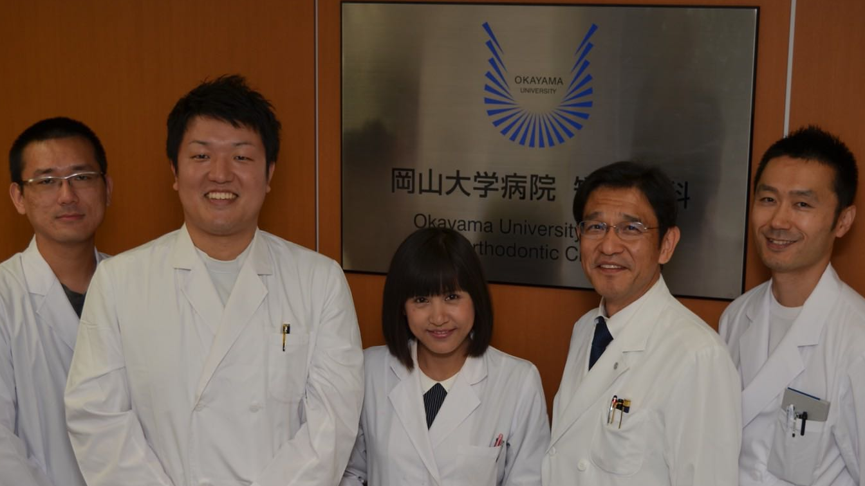
Welcome to visit my personal website (http://www.wong-ziyi.com/) to download a script for reproduction of the bioinformatic analysis in this study.
Special thanks to Dr. Mitsuhiro Hoshijima¹ and Dr. Takanori Ishikawa² for their excellent technique support.
Me¹
Dr. Naoya Odagaki²
Affiliations:
1.Department of Orthodontics, Okayama University Graduate School of Medicine, Dentistry, and Pharmaceutical Sciences, Okayama, Japan.
2.Department of Orthodontics, Okayama University Hospital
Dr. Yoshihito
Ishihara²
Pro. Hiroshi
Kamioka¹
Dr. Ei Ei Hsu Hlaing¹
Acknowledgment
The present work was supported by Grant-in-Aid for Scientific Research (to H. Kamioka [16H05549] and [16K15837], to Y. Ishihara [17H04413]) from the Japan Society for the Promotion of Science, Japan.
Notes:
Thanks for your attation.

Slide 26
Gene
mRNA
Protein
Egln1
Egln1
Prolyl-4-hydroxylase (PHD) domain-containing protein 1)
Pdk1
Pdk1
Pyruvate dehydrogenase kinase 1
Mxi1
Mxi1
Max-interacting protein 1
Slc5a3
Slc5a3
Sodium/myo-inositol transporter
Ccng2
Ccng2
Cyclin-G2
Higd1a
Higd1a
HIG1 domain family 1A
Eno2
Eno2
Gamma-enolase
Review of Previous Studies
Notes:
First, let’s have a look that what proteins do these mechano-sensitive genes encode.

Slide 27
Gene
mRNA
Protein
HIF1-α
Hypoxic Response
Mitochondrial Tricarboxylic Acid Cycle
Egln1
Egln1
Prolyl-4-hydroxylase (PHD) domain-containing protein 1
Wenger RH, et al (2005) Sci Signal; Kim J, et al (2006) Cell Metab
Pdk1
Pdk1
Pyruvate dehydrogenase kinase 1
↓Egln1 → trabecular bone formation↑
Bone mineral density & strength ↑
↑ Pdk1 → collagen hydroxylation ↓
SOST transcription
Wu C , et al (2015) Genes Dev;
Huang J, et al (2015) Mol Med Rep;
Liu X, et al (2014) Cell Biochem Biophys;
Peng J, et al (2014) PloS One;
Bentovim L, et al (2013) Development;
Zhang W, et al (2012) J Orthop Sci;
Stewart R, et al (2011) J Orthop Trauma;
Shen X, et al (2009) J Orthop Res;
Wan C, et al (2008) Proc Natl Acad Sci
Mxi1
Mxi1
Max-interacting protein 1
Fujiwara M, et al (2016) Bone
↓Slc5a3 →bone mass ↓, osteoblast ↓,
osteoporosis-like microarchitecture,
delayed embryonic bone formation,
shortened adult long bones
Slc5a3
Slc5a3
Sodium/myo-inositol transporter
Dai Z, et al (2011) J Bone Miner Res
Ccng2
Ccng2
Cyclin-G2
PTH
Dedifferentiation of osteocytes
Cell cycle
Ullah M, et al (2013) Differentiation
? ? ? ? ? ? ?
Prideaux M, et al (2015) PLoS One;
Bellido T, et al (2005) Endocrinology
Higd1a
Higd1a
HIG1 domain family 1A
Mitochondrial
Homeostasis
Cytochrome C
Apoptosome
Osteocytes Survival↑
Caspase
?
Ameri K, et al (2013) PLoS One;
An HJ, et al (2011) Biochim Biophys Acta – Mol Cell Res
Eno2
Eno2
Gamma-enolase
Neuromodulin
Nerve fibers expansion during fracture repair
?
AMPK
ATP Generation
mTOR
Hukkanen M, et al (1993) Neuroscience
Zhang P, et al (2017) Mol Carcinog
Notes:
And now I’m going to introduce the potential role of these proteins or genes in bone by reviewing previous studies.
Prolyl-4-hydroxylase domain-containing protein 1 is one of the PHD enzymes which could degrade the HIF1-alpha. And HIF1-alpha is a crucial regulator to activate the hypoxic response. Interestingly previous studies also showed that HIF1-alpha could activate the transcription of Pdk1 directly and the activation of the pyruvate dehydrogenase kinase1. This kinase is an inhibitor of the mitochondrial Tricarboxylic Acid Cycle, which means that it could reduce the ATP generation. So, consistent with those interactions, osteoblast-specific deletion of Egln1 gene in mouse increased the trabecular bone formation, bone mineral density and bone strength, while the decreased collagen hydroxylation in this kind of mouse possibly caused by the increased expression of Pdk1.
Mxi1 encodes max-interacting protein 1, a transcription factor, was shown to suppress sclerostin transcription in human dermal fibroblast in a recent study.
Sodium/myo-inositol transporter, is a kind of membrane transport proteins, which could aid the transportation of inositol to increase the calcium releasing from endoplasmic reticulum. Agreement with its function, Slc5a3 knockout mice showed delayed embryonic bone formation, shortened adult long bones, reduced bone mass, decreased numbers of osteoblasts, and osteoporosis-like microarchitecture.
Although, it is generally accepted that after differentiation, bone marrow mesenchymal stem cells become lineage-restricted and the terminal differentiated cell type- the osteocyte – become irreversible. While, a recent study observed the de-differentiation of osteocyte under parathyroid hormone treatment both in vivo and in vitro. More earlier, there already is a report showed the de-differentiation of human adipose cells that differentiated from the mesenchymal cell. The point is, both of these two studies showed changes in the expression of cell cycle related genes. And our study showed that, Ccng2 a negative regulator of cell cycle was extremely mechano-sensitive. So, is it possible that cell cycle genes in osteocyte could induce its de-differentiation?
HIG1 domain family 1A is a protein that promotes mitochondrial homeostasis and the survival of cells under stress by inhibiting cytochrome C release and caspase activity. But its role in osteocyte is not confirmed yet.
Gamma-enolase the hub gene in our study, showed inhibition of Neuromodulin. Neuromodulin is a protein encoded by Gap43 that could induce the growth of neural cells processes. While, does Eno2 involved in the nerve fibers expansion during fracture repair that reported in past?

Slide 28
Gene
mRNA
Protein
HIF1-α
Hypoxic Response
Mitochondrial Tricarboxylic Acid Cycle
Egln1
Egln1
Prolyl-4-hydroxylase (PHD) domain-containing protein 1
Wenger RH, et al (2005) Sci Signal; Kim J, et al (2006) Cell Metab
Pdk1
Pdk1
Pyruvate dehydrogenase kinase 1
↓Egln1 → trabecular bone formation↑
Bone mineral density & strength ↑
↑ Pdk1 → collagen hydroxylation ↓
SOST transcription
Wu C , et al (2015) Genes Dev;
Huang J, et al (2015) Mol Med Rep;
Liu X, et al (2014) Cell Biochem Biophys;
Peng J, et al (2014) PloS One;
Bentovim L, et al (2013) Development;
Zhang W, et al (2012) J Orthop Sci;
Stewart R, et al (2011) J Orthop Trauma;
Shen X, et al (2009) J Orthop Res;
Wan C, et al (2008) Proc Natl Acad Sci
Mxi1
Mxi1
Max-interacting protein 1
Fujiwara M, et al (2016) Bone
↓Slc5a3 →bone mass ↓, osteoblast ↓,
osteoporosis-like microarchitecture,
delayed embryonic bone formation,
shortened adult long bones
Slc5a3
Slc5a3
Sodium/myo-inositol transporter
Dai Z, et al (2011) J Bone Miner Res
Ccng2
Ccng2
Cyclin-G2
PTH
Dedifferentiation of osteocytes
Cell cycle
Ullah M, et al (2013) Differentiation
? ? ? ? ? ? ?
Prideaux M, et al (2015) PLoS One;
Bellido T, et al (2005) Endocrinology
Higd1a
Higd1a
HIG1 domain family 1A
Mitochondrial
Homeostasis
Cytochrome C
Apoptosome
Osteocytes Survival↑
Caspase
?
Ameri K, et al (2013) PLoS One;
An HJ, et al (2011) Biochim Biophys Acta – Mol Cell Res
Eno2
Eno2
Gamma-enolase
Neuromodulin
Nerve fibers expansion during fracture repair
?
AMPK
ATP Generation
mTOR
Hukkanen M, et al (1993) Neuroscience
Zhang P, et al (2017) Mol Carcinog
Notes:
And now I’prolm going to introduce the potential role of these proteins or genes in bone by reviewing previous studies. Prolyl-4-hydroxylase domain-containing protein 1 is one of the PHD enzym

